Slide 1
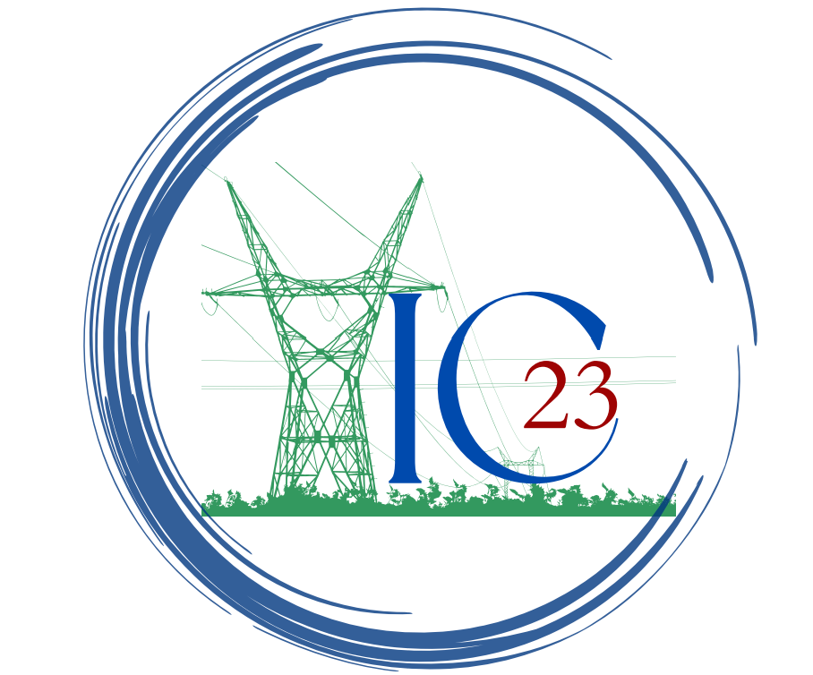
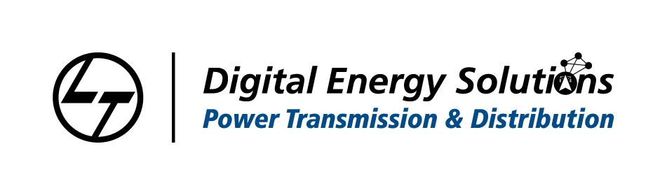
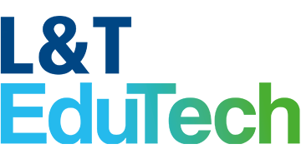
Power line inspection using unmanned aerial vehicles (UAVs) and computer vision
Ideation Challenge 2023
Team Name :Coders Spot
Institute Name:Velammal Institute of Technology

Slide 2
Team Details
Problem Theme : Power System use cases using Computer Vision
Team Name: Coders Spot
Team Leader Name: ARAVIND RAJ N
Branch (B.Tech/M.Tech/Ph.D etc.): B.E
Stream (EEE,CSE, etc.): CSE
Year(I,II,III,IV): III
Team Member 1 Name: Vaideeshwaran A
Branch (B.Tech/M.Tech/Ph.D etc.): B.E
Stream (EEE,CSE, etc.): CSE
Year(I,II,III,IV): III
Team Member 2 Name: Thillai Krishna R
Branch (B.Tech/M.Tech/Ph.D etc.): B.E
Stream (EEE,CSE, etc.): EEE
Year(I,II,III,IV): III
Team Member 3 Name: AKASH S
Branch (B.Tech/M.Tech/Ph.D etc.): B.E
Stream (EEE,CSE, etc.): EEE
Year(I,II,III,IV): III
Team Mentor Name: A. Anbumani
Stream (EEE,CSE, etc.): CSE
Designation: Assistant Professor

Slide 3
Problem Statement

Slide 4
Problem Statement
Power transmission lines require regular inspections to ensure their structural integrity, detect faults, and prevent potential outages. Manual inspections are time-consuming, expensive, and can be dangerous for workers who have to climb towers or work in close proximity to high voltage lines. Moreover, they cannot cover large areas efficiently

Slide 5
Abstract

Slide 6
Abstract
Power line inspection is a crucial task in the power industry, as it ensures the safe and efficient operation of power transmission systems. However, traditional inspection methods involving human workers to physically climb the power lines pose significant safety risks and are time-consuming. To address these challenges, our company provides a solution for power line inspection using unmanned aerial vehicles (UAVs) and computer vision technology. Our system allows for quick and safe inspections, reducing the need for human workers to physically climb the power lines. By using high-resolution cameras and advanced algorithms, our UAVs can detect and identify potential faults or damages, allowing for faster repairs and reducing downtime. Our solution is not only more efficient and cost-effective than traditional inspection methods but also significantly improves safety for workers. In this abstract, we highlight the benefits of our technology for power line inspection and its potential to revolutionize the power industry.

Slide 7
Innovation Details

Slide 8
Innovation Details
Power line inspection using unmanned aerial vehicles (UAVs) and computer vision technology is an innovative solution for the power industry that offers a number of benefits over traditional inspection methods.
The use of UAVs equipped with high-resolution cameras and advanced algorithms enables quick and safe inspections of power lines, reducing the need for human workers to physically climb the power lines. This significantly improves safety for workers and reduces the risk of accidents and injuries.
The use of computer vision technology allows for the detection and identification of potential faults or damage in power lines, enabling faster repairs and reducing downtime. This results in increased efficiency and reduced costs associated with power line maintenance and repair.
Furthermore, the implementation of UAVs for power line inspection is environmentally friendly, as it reduces the need for fossil fuel-powered vehicles and machinery. This contributes to the overall sustainability and energy efficiency of the power industry.
Overall, power line inspection using UAVs and computer vision technology is an innovative and promising solution that offers numerous benefits for the power industry, including increased safety, efficiency, and sustainability.

Slide 9
Innovation Details – Feasibility
The use of UAVs for power line inspection offers a number of benefits over traditional inspection methods, including increased speed, accuracy, and safety. The high-resolution cameras and advanced algorithms used in the technology allow for the detection and identification of potential faults or damage in power lines, enabling faster repairs and reducing downtime. Additionally, the use of UAVs significantly reduces the need for human workers to physically climb the power lines, which significantly improves safety for workers and reduces the risk of accidents and injuries.
The practicality of this technology is further supported by its environmental benefits. The use of UAVs for power line inspection reduces the need for fossil fuel-powered vehicles and machinery, contributing to the overall sustainability and energy efficiency of the power industry.
However, the implementation of UAVs for power line inspection may initially involve some challenges and costs associated with acquiring and operating the technology. Nonetheless, the benefits of the technology, including increased efficiency and cost savings, make it a highly attractive investment in the long run.
Overall, the feasibility and practicality of power line inspection using UAVs and computer vision technology have been well-established, with the technology offering numerous benefits for the power industry, including increased safety, efficiency, and sustainability.

Slide 10
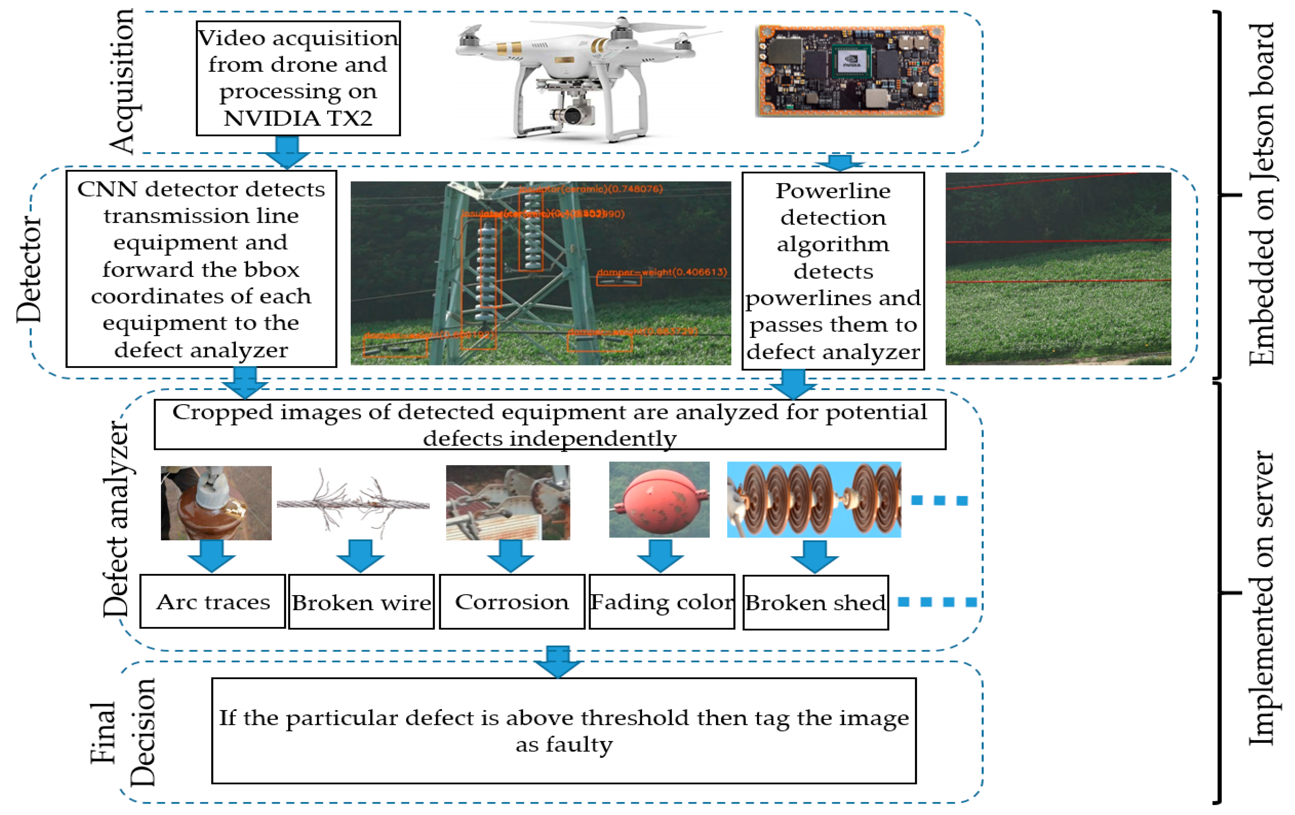
Innovation Details - Process Flow Chart

Slide 11
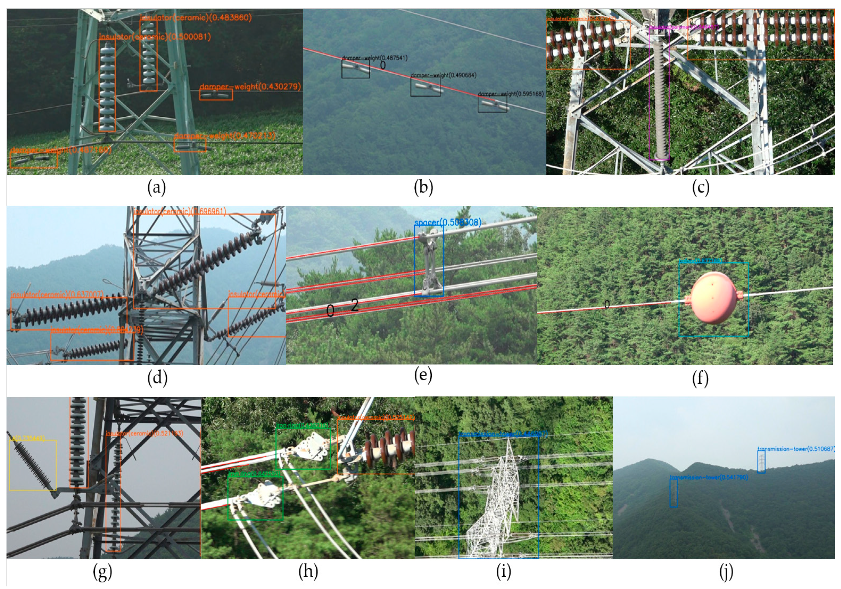
Innovation Details - Process Flow Chart

Slide 12
Innovation Details – Technology Stack
UAVs: Small unmanned aerial vehicles equipped with high-resolution cameras, GPS systems, and communication equipment for remote operation. These UAVs are designed to navigate and inspect power lines safely and efficiently.
Cameras: High-resolution cameras mounted on the UAVs to capture images and videos of the power lines.
Computer Vision Software: Advanced algorithms and machine learning models are used to analyze the images and videos captured by the cameras. These algorithms can detect and identify potential faults or damage in power lines, enabling faster repairs and reducing downtime.
Communication Systems: Communication systems are used to transmit the data and images captured by the UAVs to the control center.
Data Storage and Analysis: Data storage and analysis systems are used to store and analyze the data collected during power line inspections. This data can be used to identify trends and patterns and inform maintenance and repair decisions.
Remote Control and Monitoring Software: Software is used to remotely control and monitor the UAVs during power line inspections. This software typically includes a user interface for the operator to view the images and videos captured by the cameras and to control the UAVs.

Slide 13
Innovation Details – Unique Selling Points
Increased Efficiency: UAVs can inspect power lines much faster than human workers, reducing the time and cost associated with inspections.
Enhanced Safety: Power line inspections are inherently dangerous, requiring workers to climb up high and work in precarious positions. The use of UAVs eliminates this risk, making inspections safer and reducing the likelihood of accidents and injuries.
Accurate Data Collection: The use of high-resolution cameras and advanced algorithms in the technology ensures that inspections are thorough and accurate. This improves the detection of potential faults and damage, reducing the risk of equipment failures and downtime.
Remote Operation: UAVs can be operated remotely, allowing inspections to be conducted from a safe distance. This reduces the need for workers to travel to and from remote locations and enables inspections to be conducted in difficult-to-reach areas.
Environmental Benefits: The use of UAVs reduces the need for fossil fuel-powered vehicles and machinery, contributing to the overall sustainability and energy efficiency of the power industry.
Cost Savings: By reducing the time and cost associated with power line inspections, the use of UAVs and computer vision technology can result in significant cost savings for power companies.

Slide 14
Economic Impact

Slide 15
Economic Impact
Cost Savings: Traditional power line inspection methods can be time-consuming and labor-intensive, requiring workers to climb up and visually inspect each power line. The use of UAVs and computer vision technology can significantly reduce the time and labor costs associated with inspections, resulting in cost savings for power companies.
Improved Maintenance: By identifying and addressing potential faults and damage more quickly, UAVs and computer vision technology can help prevent power outages and equipment failures. This can result in fewer costly repairs and less downtime for power companies.
Enhanced Efficiency: The use of UAVs and computer vision technology can enable faster and more efficient inspections, allowing power companies to cover a larger area in less time. This can improve overall operational efficiency and increase revenue for power companies.
Increased Safety: Power line inspections can be dangerous for human workers, requiring them to climb up high and work in precarious positions. By using UAVs and computer vision technology, power companies can reduce the risk of accidents and injuries, leading to fewer worker compensation claims and potential legal liabilities.
Competitive Advantage: Adopting UAVs and computer vision technology for power line inspections can give power companies a competitive advantage in the industry. It demonstrates a commitment to safety, sustainability, and innovation, which can attract new customers and investors.

Slide 16
Contact Details
Please provide your single point of contact.
Name: ARAVIND RAJ N Phone No: 8939497678 E-mail Id: aravindraj.engineer@gmail.com

Slide 17
Thank You!

